Slide 1


CINEBOOK
Online Movie Ticket Booking System
TCA Cine
TRẦN LÊ MINH ANH
ĐINH LÊ HOÀNG CHÂU
TĂNG HUỲNH TUẤN TÚ
INSTRUCROR:LÊ MỘNG THUÝ

Slide 2

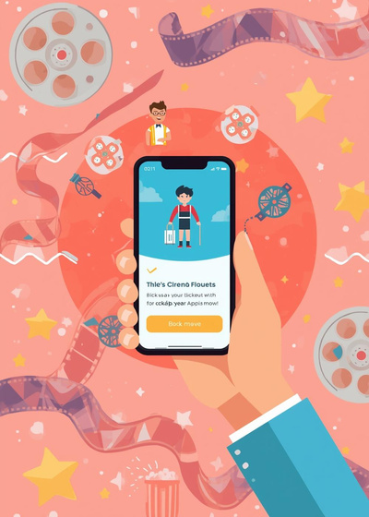
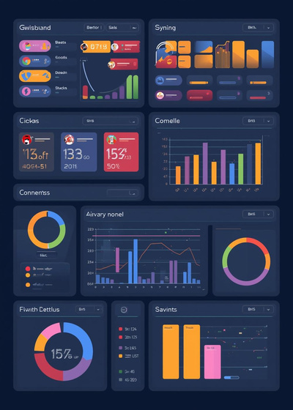

Project Objectives
TRANSITION FROM TRADITIONAL OPERATIONS TO ONLINE SYSTEMS
Convenience
Optimized Management
Data Management
Users can book tickets easily, without waiting in line at the cinema.
Reduce manual errors and manage data in a centralized system.
Data is stored securely and synchronized across the entire system.

Slide 3

User Groups

Slide 4

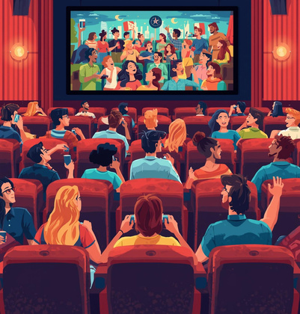
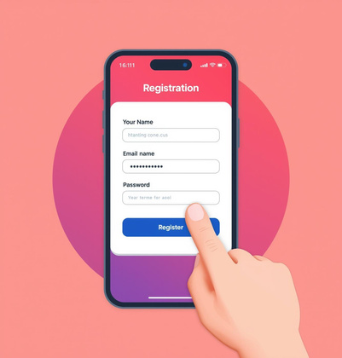
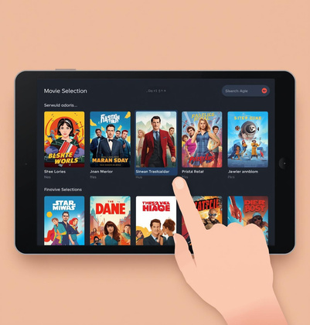
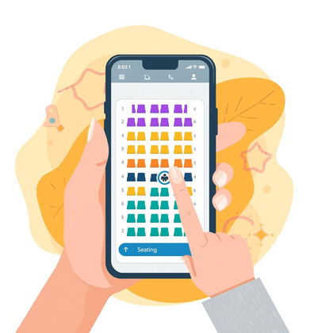
User Group – Customer (User)
Registration
Seat Selection
Users can create an online account easily.
Users select available seats in real time.
Movie List
Receive E-ticket
Promotion List
View and choose favorite movies at any time.
View cinema promotions anytime, anywhere.
Get an electronic ticket immediately after booking.

Slide 5
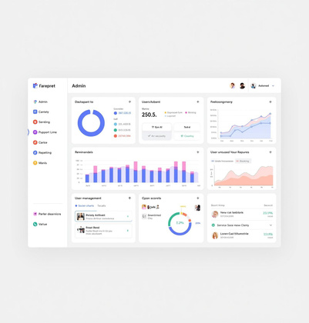




User Group – Administrator (Admin)
User Management
Movie Management
Manage user accounts and assign roles.
Add, edit, or delete movies.
Update movie information and genres.
Screening Room Management
Booking Management
Review Management
Track ticket status and accurate revenue data.
Monitor and manage customer reviews.
Manage showtimes and seating layouts efficiently.

Slide 6

Technologies Used

Slide 7
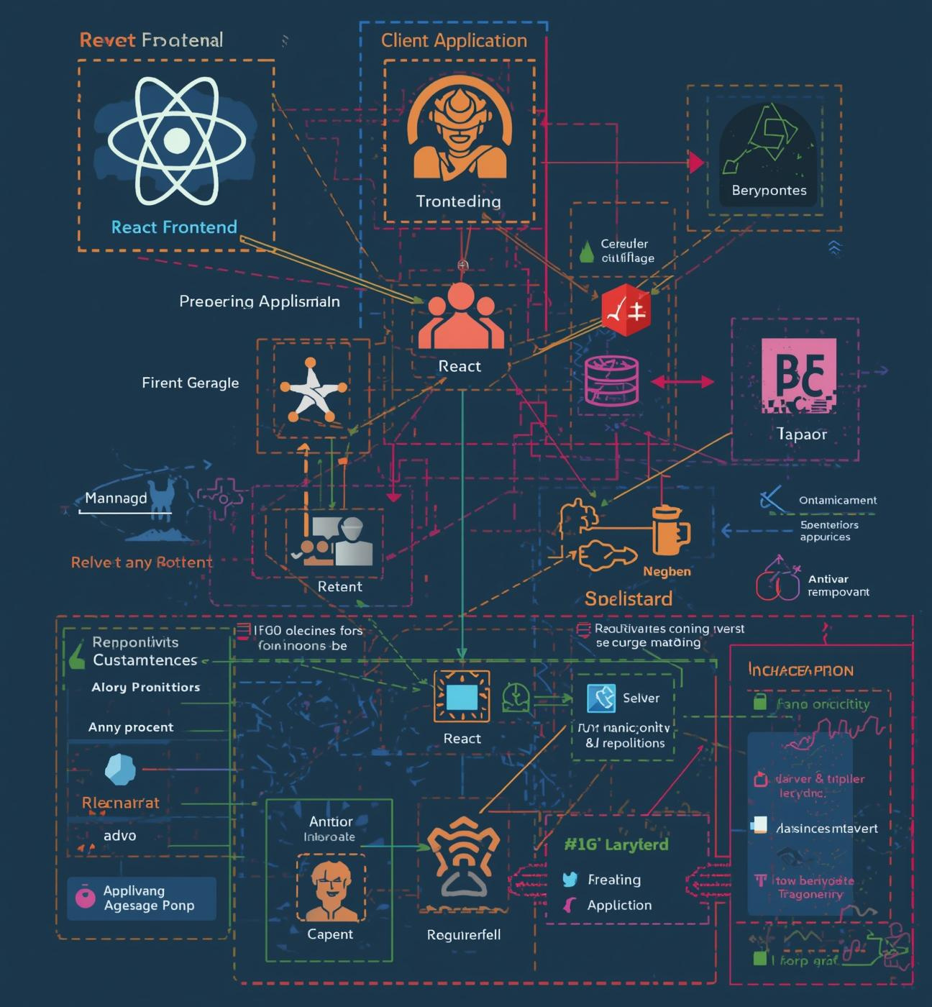
System Architecture
The system uses a Client–Server architecture.
The user interface is built with HTML, Bootstrap CSS, and JavaScript, providing a smooth and interactive experience.
The Laravel framework handles business logic and data management, ensuring that all system requests are processed accurately and efficiently.

Slide 8

Backend Technology
PHP - LARAVEL FRAMEWORK
MySQL (Database)
The CineBook system is developed on the PHP platform using the Laravel framework.
It follows the Client–Server model, allowing efficient request handling and real-time data processing.
MySQL is used to manage centralized and structured system data.

Slide 9

Frontend Technologies Used
HTML
Provides the basic structure of the user interface.
BOOTSTRAP CSS
Handles layout, styling, and responsive design for web pages.
JAVASCRIPT
Enhances user interaction and dynamic behavior in the web application.

Slide 10
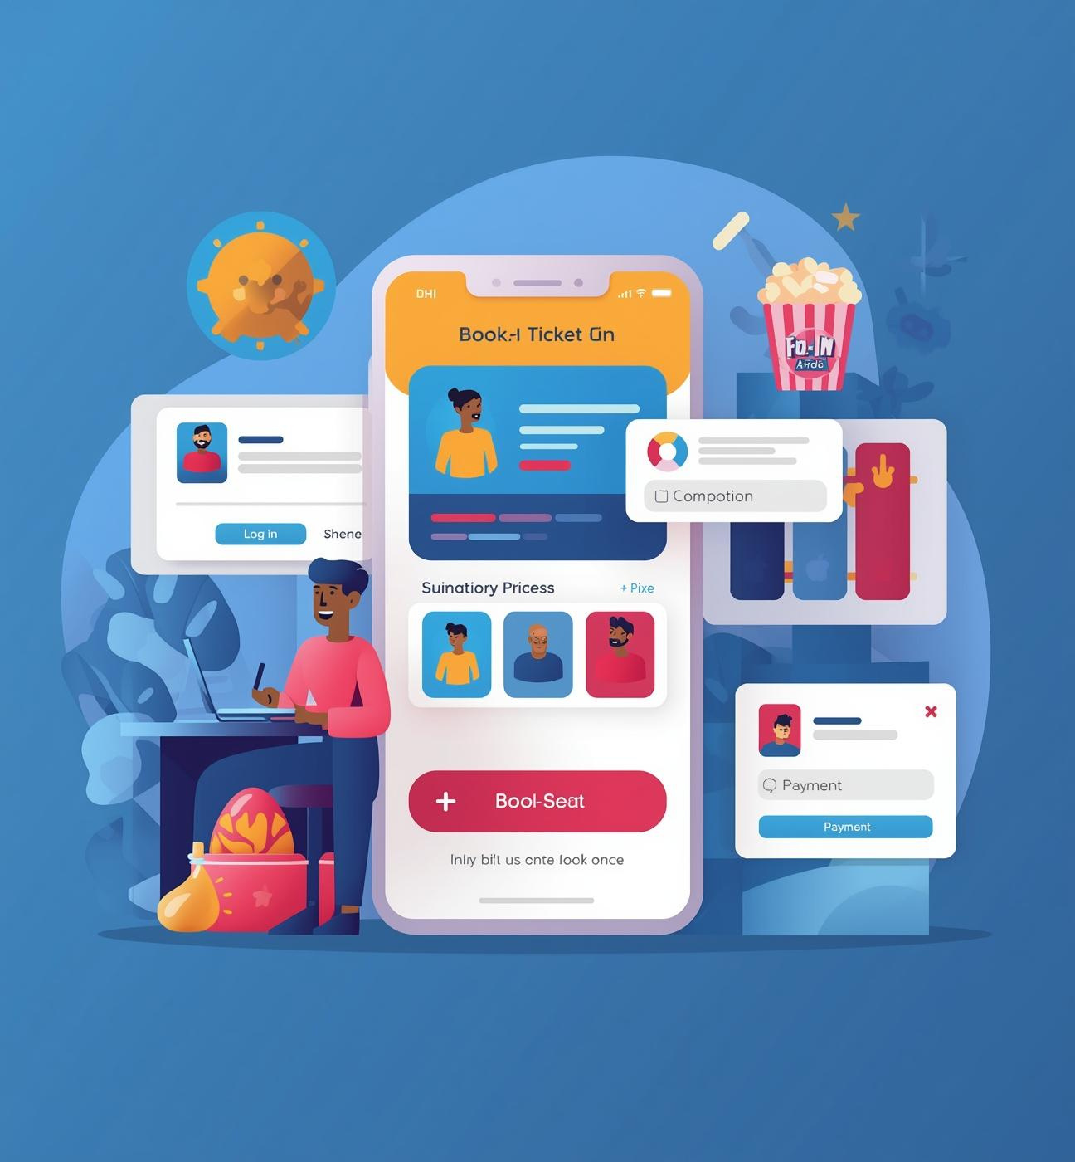
Booking Process

Slide 11
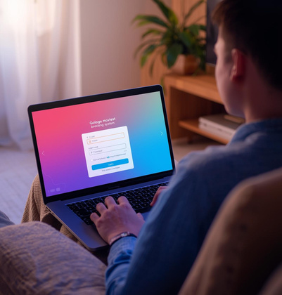
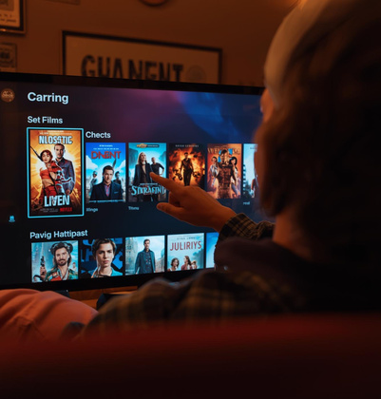
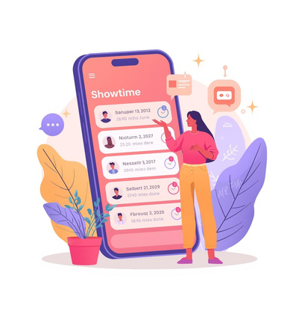
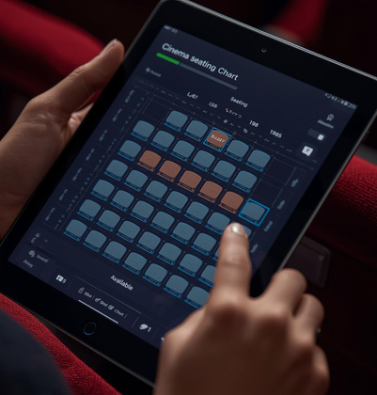
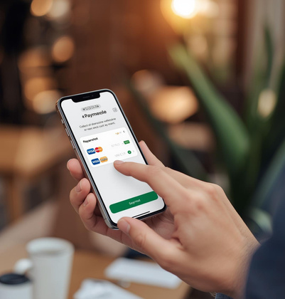

User Booking Process
Login
Choose Movie
Choose Showtime
Users log in using their account information to access the system.
Users select a movie from the available movie list.
Users choose a suitable showtime for watching the movie.
Choose Seat
Payment
Movie Review
Users select their preferred seats in real time.
Users complete the payment to receive the ticket.
Users can leave a review after watching the movie.

Slide 12
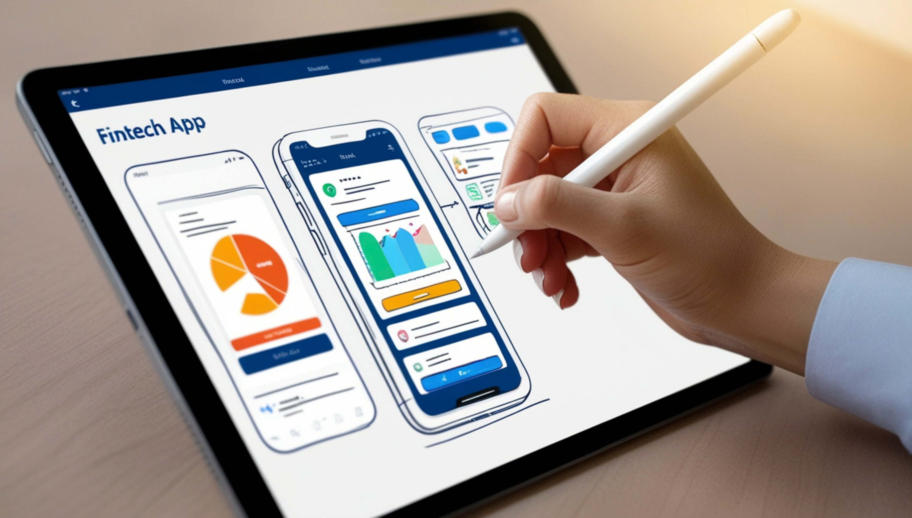
Management Process

Slide 13
Admin Management Functions
Account Management
Movie Management
Showtime Management
Manage user accounts and assign roles and permissions.
Add, edit, and delete movies (CRUD).
Manage movie categories and genres.
Manage screening rooms, screen types, seats, and showtimes.
Booking & Payment Management
Revenue Management
View basic revenue and sales reports.
Manage bookings and track ticket status.

Slide 14



Task Assignment Table
Group monitor
Trần Lê Minh Anh
Name | Tasks | % Participation
TRẦN LÊ MINH ANH | DATABASE: MOVIE, GENRES, ROOMS, SCREEN, SHOWTIMES BACK-END & FRONT-END: Seat map, select seat, confirm booking, payment, e-ticket, sent email, homepage, movie list, promotions Tài liệu: Review 1 | 100%
ĐINH LÊ HOÀNG CHÂU | DATABASE: USER, REVIEW,BOOKING, BOOKING SEATS, SHOWTIME SEAT BACK-END & FRONT-END: User profile, user booking history, user review, login/out, register, password recovery, sent email. Tài liệu: Review 2 + Video clip | 100%
TĂNG HUỲNH TUẤN TÚ | DATABASE: SEATS, SEAT TYPES, SHOWTIMES, SHOWTIME PRICE, PROMOTIONS BACK-END & FRONT-END: Admin dashboard, quản lý phim, quản lý phòng chiếu, quản lý suất chiếu, quản lý và phân quyền tài khoản Tài liệu: Review 3 | 100%

Slide 15






THANK YOU

